Slide 1
Methodological Integration Prepared by Govinda Tamang,Ph.D.
12/5/2024, 12/19/2024

Slide 2
Pretend that you are interested in conducting the research on the following topic:
Business Intelligence system and organizational performance in the corporate sector
How would you design your study?

Slide 3
Research Approaches
Theory
Induction
Theory building
Deduction
Theory testing
Research Approaches
The relationship between theory and data
Generalisations
Hypotheses
Data
(Adapted from Saunders et al, 2012, pp. 144-146)

Slide 4
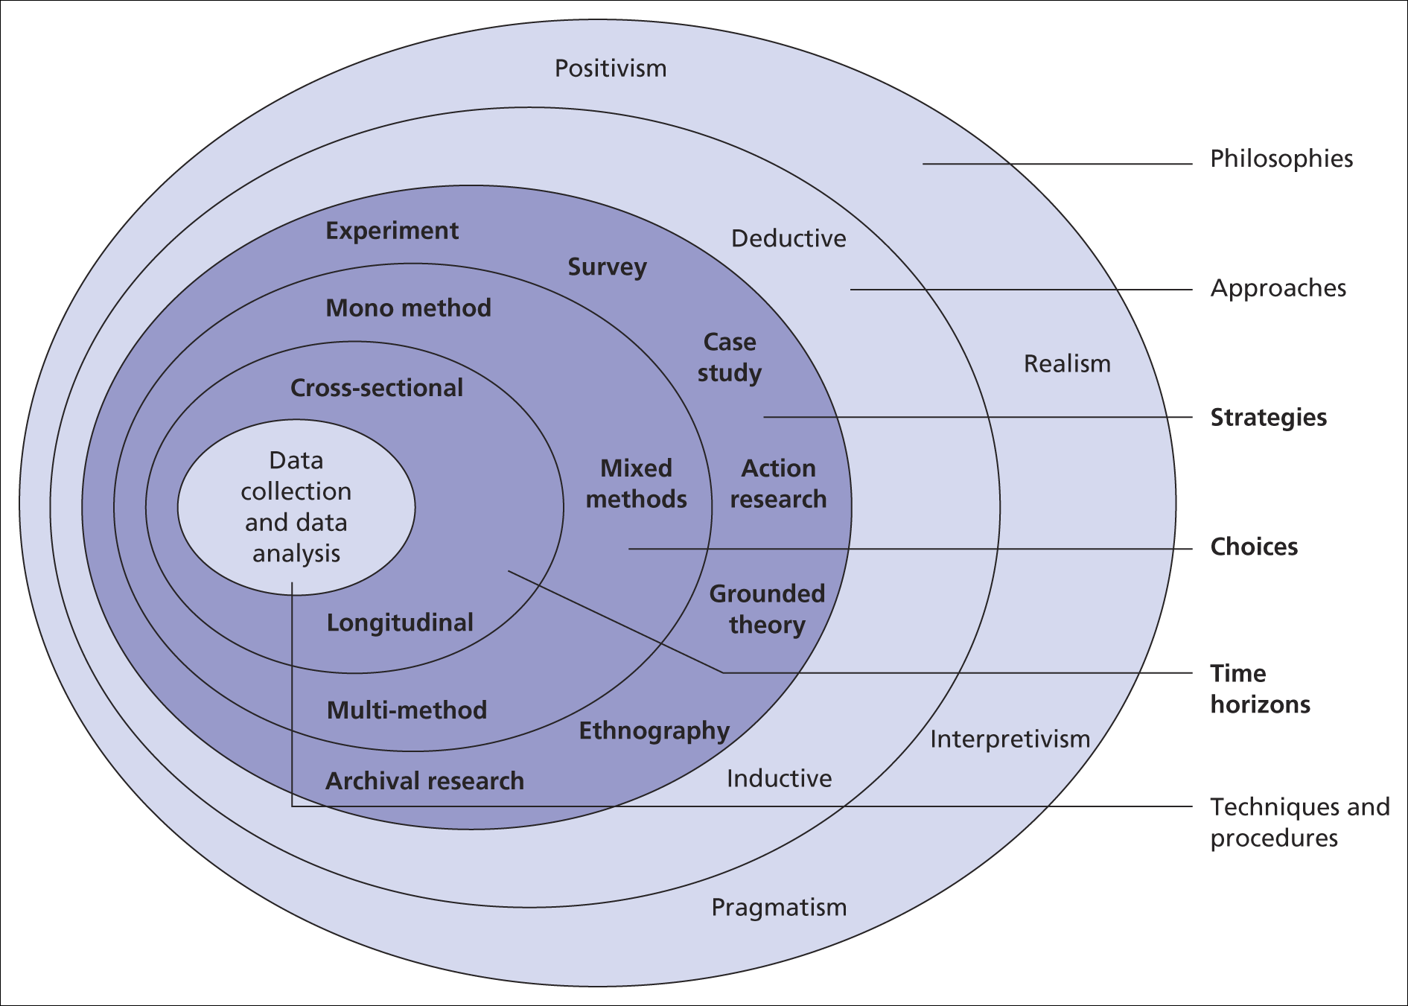
Research Onion
Source: Saunders et al, (2009)

Slide 5
Research Onion Terminology
Ontology: The nature of reality
Epistemology: How do we know about the reality?
Approach: Relationship with theory
Methodology: the broad type of research
Methods : data collection techniques/procedure
Data: type of evidence collected
Analysis: Methods used to make sense of data

Slide 6
Positivism, Realism & Objectivity
 | Positivism
Ontology | Reality is objective, singular & observable; apart from the researcher
Epistemology | Valid knowledge is objectively observable; empirical regularities lead to causal laws; tests hypotheses; researcher is independent from the researched
Values and Biases | Value-free, unbiased, impersonal
Methodology | Deductive process; operationalises variables; reduce to simple elements (“reductionism”); generalisations leading to prediction, explanation and understanding; accurate through validity and reliability
Methods | Self completed questionnaire; highly structured interviews; use of secondary data
Types of Data | Quantitative; directly observable and measurable
Language | Formal, impersonal (use of third person – ‘the researcher found that…’)

Slide 7
 | Subjectivism
Ontology | Reality is subjective
Epistemology | Interpretivism; knowledge is immeasurable; researcher is close to researched
Values and Biases | Value-laden, biased, personal
Methodology | Qualitative; observations and reflection on data lead to theory generation and understanding; looks for patterns; accurate through range of aspects e.g. convincing, feasible
Methods | Interviews, focus groups, ethnography, observation, case studies, documentary analysis, visual content analysis, archival research, open questions
Types of Data | Qualitative; thick in-depth data, i.e. quotes, images, documents, video, body language
Language | Informal, personal (use of first person – ‘I believe that…’)
Approach | Inductive
(Adapted from Burrell & Morgan, 1979; Creswell, 1994; Wass & Wells, 1994b; Hussey & Hussey, 1997; Easterby-Smith et al, 2012; Fleetwood, 2013)
Notes:
Here, I’ve set out details about how these terms link to the paradigm associated with qualitative research and qualitative research methods often associated with subjectivism

Slide 8
The Deductive Research Process
Theory
Hypothesis
Selection of Respondents or Subjects (sample)
Operationalise Concepts
Survey Design Secondary Analysis Meta-Analysis Experimental Design
Collect Data
Analyse Data (to confirm / refute hypothesis)
Produce Findings
Notes:
This is the deductive research process. It’s the process in which we carry out research that usually uses quantitative data collection methods. You start off with the theory. This may have been derived from the academic literature (e.g. research books or journal articles). You then form a hypothesis from this theory that you wish to test to see if it’s true or not. We’ll be talking about operationalising concepts next lecture. This looks at the variables in the hypothesis and tries to find ways of measuring those. You then select respondents/sample. You carry out the data collection through a questionnaire, face to face survey, meta-analysis or carrying out an experiment. This data is then analysed following accepted statistical techniques. These will either add further evidence to the hypotheses or provide evidence of the hypotheses failing. These findings then form part of piece of research (e.g. a journal article) which goes back and forms part of the theory that someone else can test in their research.

Slide 9
The Inductive Research Process
Selection of respondents or subjects
Collect data and information through Observation / Interaction (Data collection methods could include focus groups, interviews, ethnography, observation, discourse analysis)
Ask questions and reflect on data
Produce insight, findings and form categories
Look for patterns and form descriptive explanations of social world (Theories)
Researcher develops a theory or compares pattern with other theories

Slide 10
Methodological integration
Mixed- method
Triangulation

Slide 11
Methodological integration
Creates the knowledge in the area of concern
One of the manifestations in methodological integration is triangulation.
The essence of triangulation is to look at issues from different , at least tow points of view
Concept of triangulation taken from military strategies
Triangle – knowledge on the sides of the triangle
To reduce the dichotomy between quantitative and qualitative approach

Slide 12
Reading materials
Chapter 22 on Methodological Integration in Social Research Pg 275 ( Social Research in Developing Countries)
Original paper Analysis of Research Approaches Integration in Marketing –Methodological and Empirical aspects

